Slide 1





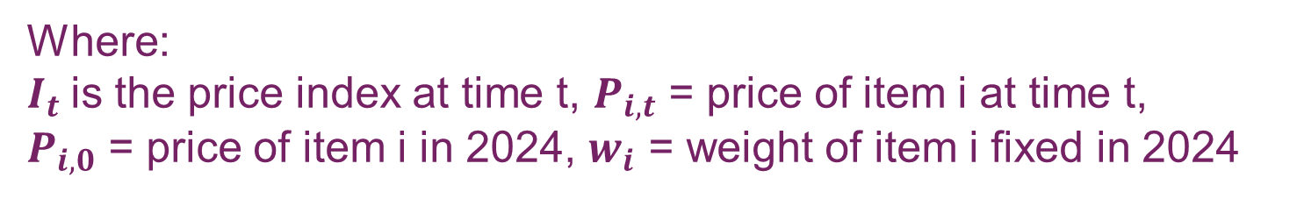
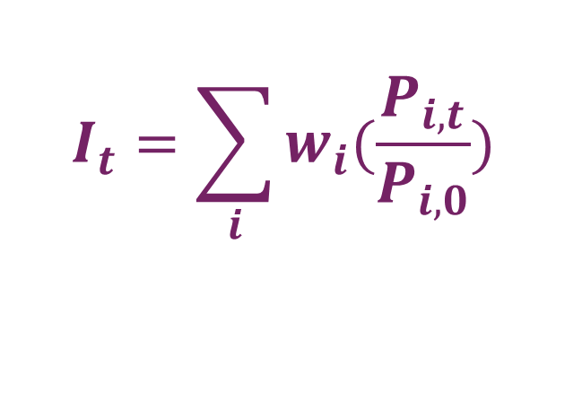
Reusing CPI Price Data to Compile an Experimental Health Services PPI: Singapore’s Experience
40th Meeting of the Voorburg Group on Service Statistics
Edwin Boey, Foo Chuanyang, Chan Zi Qi, Li Pei Pei · Singapore Department of Statistics (DOS)
OBJECTIVE
Constructing an Experimental Health SPPI Using Existing CPI Price Data for Deflation and Analyses of Healthcare Provider Price Trends
Why a Health SPPI?
Index structure
Results
CONSUMER PAYS
PRODUCER RECEIVES
LEVEL 1
Health SPPI
Health CPI = medicines/health products + health insurance + outpatient, inpatient and other health services
The Composite Health CPI excludes medicines/health products and health insurance for better comparability with the Health SPPI.
price after subsidies
(Health CPI)
price before subsidies
(Health SPPI)
Hospital
activities
Medical & dental
activities
Other health
services
What it measures
Changes in prices paid by consumers for healthcare services
What it measures
Changes in prices received by healthcare providers for their services
LEVEL 2
DIFFERENCE
More relevant for deflating health sector output and measuring real output in the national accounts
Acute hospitals, Community hospitals
General medical services, specialists, dental services
Health SPPI
103.6
↑ 4.3% since Jan 2024
Composite Health CPI 100.6
↑ 0.7% since Jan 2024
More relevant for measuring inflation experienced by households
LEVEL 3
Home healthcare services, dialysis services
Subsidy framework revised, higher subsidies for more households
Rebates for intermediate long term care services
Conceptual Differences: Health CPI vs. SPPI
From consumer price to producer price
Oct 2024
Jul 2025
Health CPI
Health CPI
Health SPPI
Process of conversion is as follows:
Valuation
Consumer price paid; point-of-sale subsidy lowers price captured.
Producer revenue received; subsidy added back to price paid by consumer
Consumer price
Map to
subsidy group
Reverse subsidy
Producer price
Health SPPI
S-COICOP, includes:
Medicines & Health Products
Outpatient Services
Inpatient Services
Other Health Services
Health Insurance
SSIC 86* (Human Health Services)
Excludes:
Medicines & Health Products,
Health Insurance
Residential Care Services
Illustrative example
Composite Health CPI
Classification
–
Health CPI
=
Healthcare provider charges
$1,000
Subsidies
$800
Price used in CPI
$200
Weighting
Household expenditure
Producer revenue
Health SPPI
The Health SPPI rose more than the Composite Health CPI, largely because government subsidies reduces prices paid by consumers, which led to lower Composite Health CPI.
The dips seen in Composite Health CPI are explained by subsidy events, with SPPI unaffected
Scope
Business-to-consumer (B2C)
B2B / B2All
Focus on B2C for experimental index
+
=
*Equivalent to NAICS 621 and 622 or ISIC 86
Price used in CPI
$200
Subsidies
$800
Price used in PPI
$1,000
Five step development approach
Notes:
Subsidies include government subsidies and targeted in-house assistance from non-profit organisations.
Insurance payouts and payments from personal medical savings accounts are out of scope in the CPI and PPI.
Limitations
1
Determine structure & coverage
Items underlying each firm are aggregated through 3 levels based on the firm's characteristics: 5-digit SSIC → 3-digit SSIC → overall Health SPPI (SSIC 86)
Currently, item-level weights are proxied using CPI household expenditure weights, which reflect post-subsidy household spending rather than producer revenue which is more aligned to SPPI methodology.
However, the impact to the Health SPPI should not be significant as we noticed that prices move in tandem for similar services with different subsidy types.
Weights and index compilation
2
Map CPI items to SPPI categories
LEVEL 1-3 WEIGHTS
Assign every priced CPI item to its firm and its corresponding Health SPPI category. More than 5,800 CPI health services were mapped to the Health SPPI
2024 operating
revenue
%
Split by 5D SSIC
Normalise to 10,000
Aggregate from Level 3 to 1
The Health SPPI currently covers only B2C transactions, excluding B2B segments which may exhibit different pricing behaviour.
However, the B2C segment represents a more substantial share of Singapore’s healthcare activity, and future work could explore incorporating B2B to broaden the index's coverage.
Derive firm and item weights
INDIVIDUAL ITEM WEIGHTS
3
Firm-level weights are derived from 2024 operating revenue from DOS’s business data, while item-level weights within each firm are proxied using CPI weights.
In the absence of a separate PPI survey, CPI household expenditure share was used to proxy each item’s share of producer revenue before subsidy.
Convert consumer to producer prices
INDEX COMPILATION
4
Each priced item's applicable subsidy is reversed at the time it took effect to derive producer prices. Subsidies’ type and quantum vary by health service, age and income.
Index compiled using the weighted arithmetic mean Laspeyres Formula with weight and price reference year of 2024:
$$I_{t}=\sum_{i}{w_{i}(\frac{P_{i,t}}{P_{i,0}}) }$$
Next steps
Compile Health SPPI
Extend methodology to SSIC 87 Residential Care
Explore the potential use of 'InvoiceNow’, Singapore’s national e-invoicing network, when implemented, and assess whether the information captured can be used to expand the coverage of health services including B2B and more B2C transactions.
5
Item-level price relatives and weights are aggregated via weighted arithmetic mean Laspeyres (2024 as base) to form the overall Health SPPI.
Where:
$I_{t}$is the price index at time t, $P_{i,t}$ = price of item i at time t,
$P_{i,0}$ = price of item i in 2024, $w_{i}$ = weight of item i fixed in 2024
Scan to share your feedback
 
go.gov.sg/dos-vg-feedback
Contact us
Find us at
Singapore Department of Statistics
Website
 
www.singstat.gov.sg
SingStat Table Builder  
go.gov.sg/tablebuilder
Edwin_Boey@singstat.gov.sg
Foo_Chuanyang@singstat.gov.sg
Chan_Zi_Qi@singstat.gov.sg
Li_Pei_Pei@singstat.gov.sg

